Slide 1

Term deposit lead prediction solution presentation

Slide 2




Understanding the project
_ NIT JAMSHEDPUR
SITUATION
ABC is a financial company which launched “Term Deposit” scheme and observed a growth from the customers opting the term deposit scheme therefore it wants to relaunch the scheme and make sure that it has more and more subscribed customer.
complications
The campaign can be run through telephonic communication channel
The campaign can run for a short duration of time due to the budget constrained.
The company wants to shortlist top 1000 customers for its new campaign for the better conversion rate.
SOLUTION STRATEGY
Importing DATA PRESENTATION ENRICHING DATA INFORM A DECISION
Aggregated dataset

Slide 3


SOLUTION AND METHODOLOGY
_ NIT JAMSHEDPUR
IMPORTING HISTORICAL DATASET
IMPORTING NEW CUSTOMER DATASET
DATA PREPROCESSING
DATA PREPROCESSING
TARGET LIST[1000]
PROBABILITY PREDITION THROUGH LOGISTIC REGRESSION
DATA VISUALISATION
MODEL TRAINING
CONCATENATING THE CUSTOMER ID COLUMN TO THE PREDICTED PROBABILITY
FINAL CODE FILE
ACCURACY CHECK ON TEST AND TRAIN DATA SET
SORTING THE CUSTOMER ID COLUMN FOR TOP 1000

Slide 4
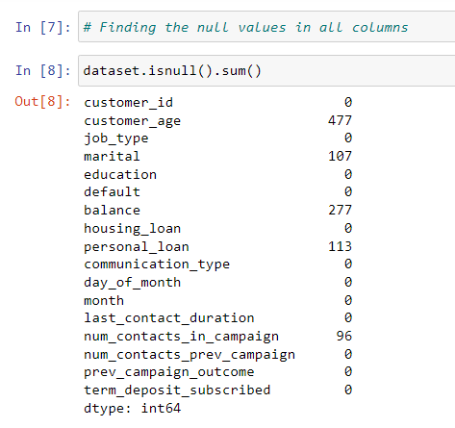
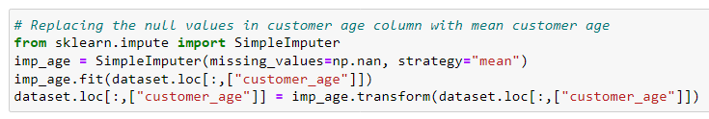
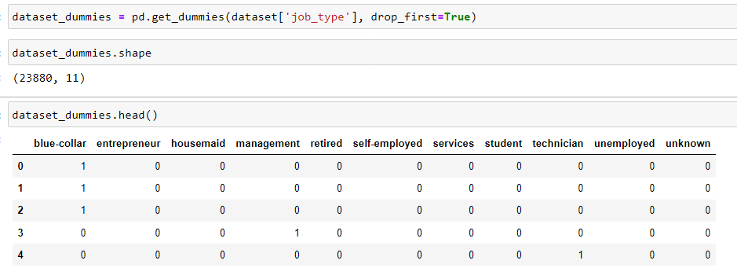
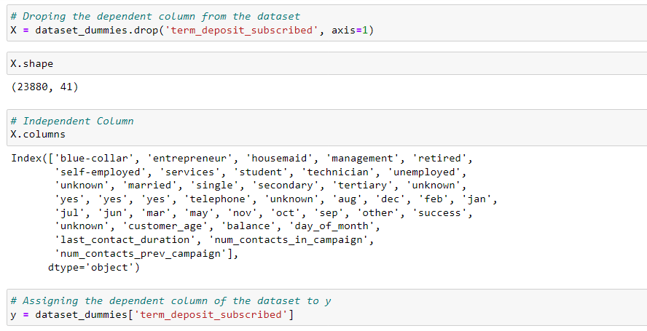
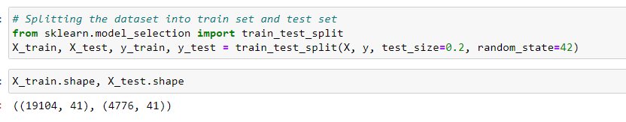
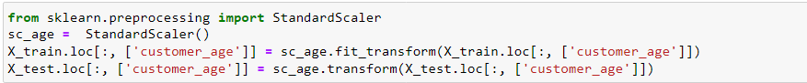
DATA PREPROCESSING
_ NIT JAMSHEDPUR
Null values identification
Null values imputation
Assigning the dummies
Splitting the data set
train data and test data
Separating the dependent and independent columns.
Numerical dataset scaling through standard scaler.

Slide 5
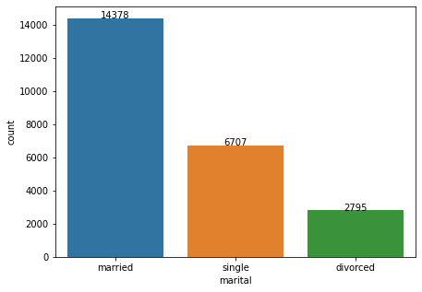
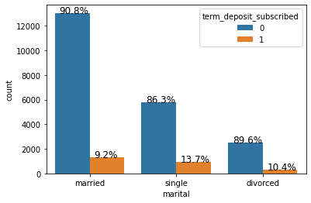
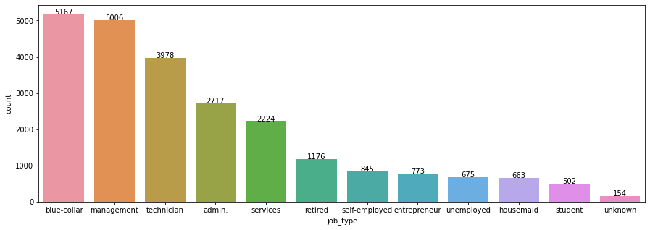
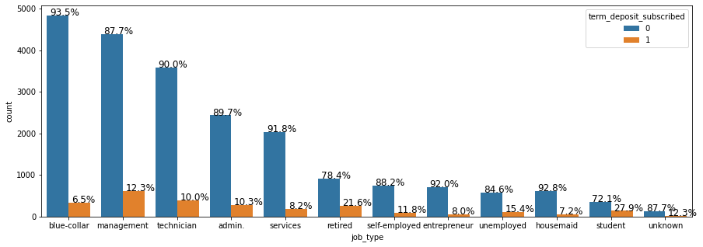
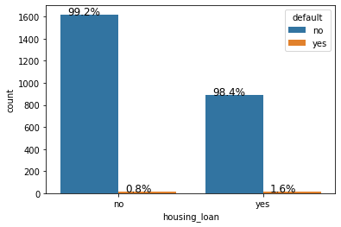
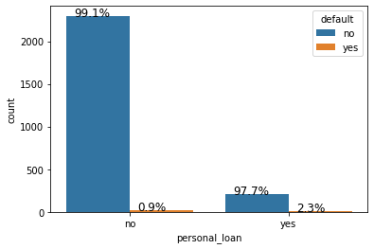
Data visualization and factors affecting the term subscribed column
_ NIT JAMSHEDPUR
MARITAL STATUS
The conversion rate is highest for the ‘Single’. Among the singles company should increase the approach to singles having education level Secondary and Tertiary.
JOB TYPE
The conversion rate is high for the ‘STUDENTS’ and RETIRED. The company should increase the approach to STUDENTS . Also follow the following preferences of EDUCATION for the other job types …..
MANAGEMENT --- MANAGEMENT --- tertiary
TECHNICIAN--- secondary/tertiary
BLUE COLLAR --- primary/secondary
ADMIN --- secondary /tertiary
RETIRED ---primary/ secondary
SERVICES --- secondary
STUDENT --- secondary
UNEMPLOYED --- secondary
SELF EMPLOYED --- tertiary
ENTREPRENEUR --- secondary/tertiary
DEFAULT
The chances of subscribing for the personal loan as well as housing loan defaulters is very less it is evident from the historical data visualization.
*Deatailed visualization is highlighted in the solution code.

Slide 6
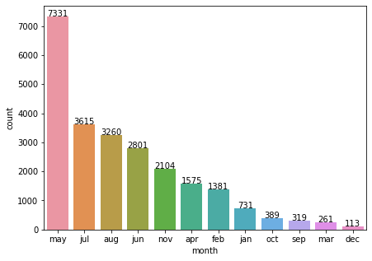
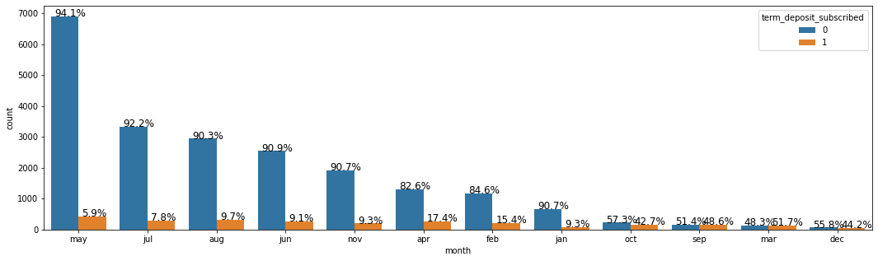
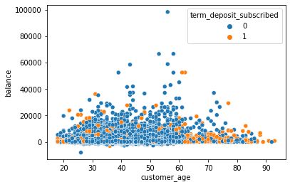
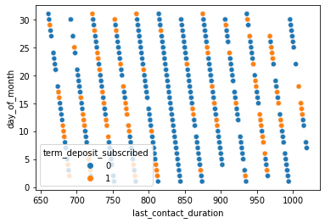
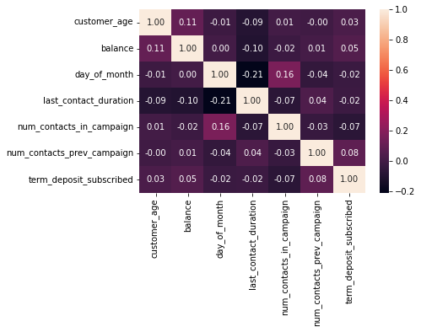
Data visualization and factors affecting the term subscribed column
_ NIT JAMSHEDPUR
The conversion percentage is SINIFICANT for the customers approached in month of
OCT,SEP,MAR,DEC
Numerical feature correlation
The conversion percentage is SINIFICANT for the customers approached which are of age group less than 20 and greater than 60 years.
The conversion percentage is SINIFICANT for the customers approached when last contacted duration is after 950 or before 820.
THANK YOU

